Slide 1


IPL Auction Analysis (2025-2026)
Presented by:
J.Anudeep Kumar
Batch No: 460
Innomatics Research Labs, Dilsuknagar
‹#›

Slide 2

Business Problem
IPL auctions are performance-driven marketplaces under budget constraints.
Lack of data-driven insights on player metrics creates uncertainty for franchises and players.
Understanding key performance indicators is essential to:
Optimize franchise decisions
Enhance player marketability
‹#›

Slide 3


Problem Statement
Selection trends and auction pricing patterns
Impact of performance metrics (batting avg, bowling avg, 40+ scores, 3-wicket hauls)
Franchise preferences for Indian vs Overseas players
Determine how factors like player performance, role, and nationality influence auction selection and final price.
‹#›

Slide 4
Objectives
Scrape IPL auction data from a relevant website and prepare it for analysis. Perform EDA and clean the dataset (handle missing values, convert numeric columns).
Analyze auction pricing trends and player selection patterns.
Explore performance metrics (batting avg, bowling avg, 40+ scores, 3-wicket hauls) and their impact.
Derive actionable insights to guide franchises and help players improve auction value.
‹#›

Slide 5
Agenda
Scrape relevant websites for required data. Clean and sort scraped data
Normalize cleaned data and establish the desired schema Univariate Analysis
Bivariate Analysis Multivariate Analysis
Insights & Recommendations Q&A
Conclusion
‹#›

Slide 6
Web Scarping
Selenium – Automated browser interaction to open pages, scroll dynamically, and load all auction player listings.
BeautifulSoup (bs4) – Parsed HTML content retrieved from Selenium for easy extraction.
Regular Expressions (re) – Extracted structured information (Player Name, Role, Country, Status, Base Price, Final Price, Team) from semi-structured text.
IPL Auction Data – Scraping Process
Opened the IPL auction webpage and automatically scrolled to load all player listings. Identified player cards in the HTML structure for extraction.
Extracted key attributes: Player, Role, Country, Status, Base Price, Final Price, Team
using Regex and BeautifulSoup.
Organized the data into a clean pandas DataFrame for analysis.
Saved the structured dataset as CSV for further processing and visualization.
‹#›

Slide 7
Tools Used:
‹#›

Slide 8
Data Preprocessing & Cleaning
Libraries Used & Their Purpose:
Pandas – Data storage, cleaning, transformation, and analysis NumPy – Numerical computations and handling missing values
Regular Expressions (re) – Extracting structured fields from semi-structured auction text
Data Cleaning & Preparation Steps:
Standardized player attributes (role, country, status, prices, team) Converted price units (Lakh/Cr) into numeric format
Transformed raw scraped text into structured columns Performed data quality checks (nulls, duplicates, summary stats)
Handled missing values logically and prepared a clean dataset for analysis
‹#›

Slide 9
Dataset Overview
The final cleaned dataset contains 521 rows and 16 columns, representing IPL auction player data collected from a relevant cricket auction website.
Key Columns & Description
Player – Identifies the cricketer
Role – Batsman / Bowler / Allrounder / WK
Country / Overseas – Indian vs Overseas classification Status – Sold / Unsold / Retained
Year – Auction year (2025, 2026)
Base Price – Entry price set by the auction Final Price – Actual auction value
Price Increase – Auction premium (Final − Base)
T20 Batting Avg – Key performance metric for batsmen/WK T20 Bowling Avg – Key performance metric for bowlers
‹#›

Slide 10
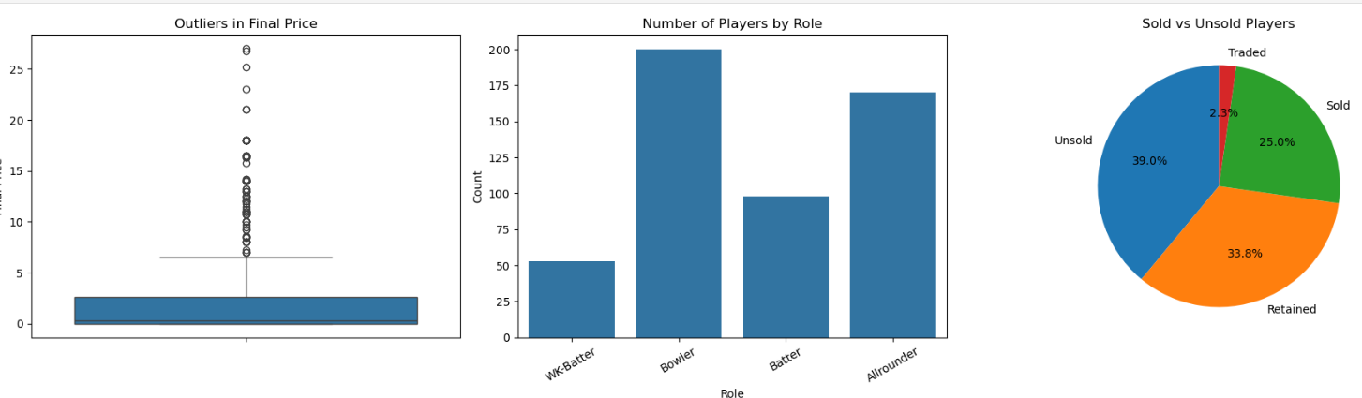
Univariate Insights
“Auction data shows high price outliers for elite players, uneven demand across roles, and strong competition reflected in sold vs unsold ratios.”

Slide 11
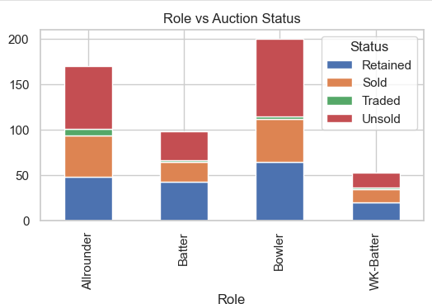
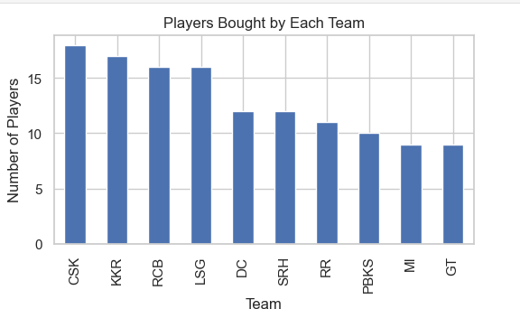
Bivariate Insights
“Auction prices are influenced by player role, base price, franchise strategy, and nationality, revealing clear patterns in selection and spending behavior.”
‹#›

Slide 12
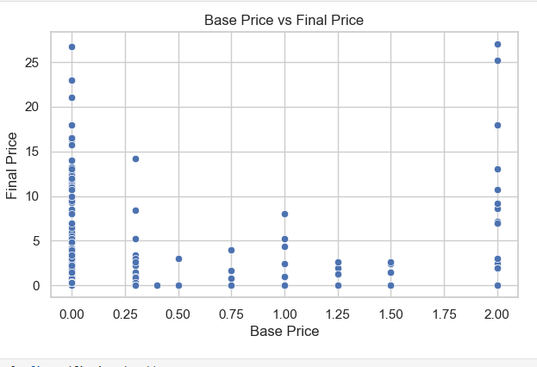
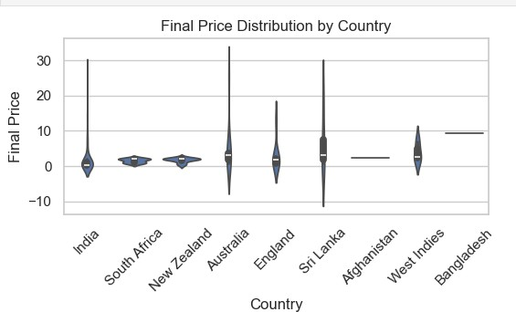
“Final auction prices generally rise with higher base prices, and overseas players show wider and higher price distributions compared to Indian players.”

Slide 13
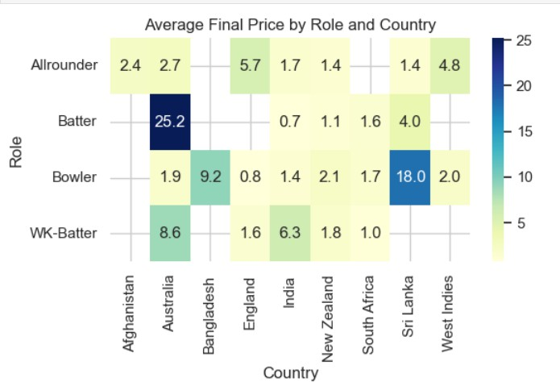
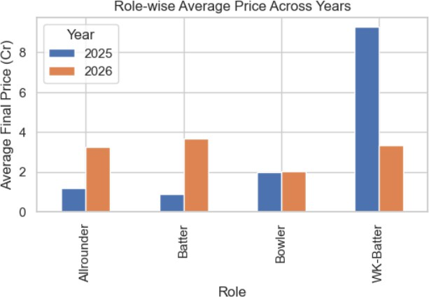
Multivariate Insights
“Average auction prices vary by role and country across years, with WK-Batters and overseas players consistently attracting higher valuations.”
‹#›

Slide 14
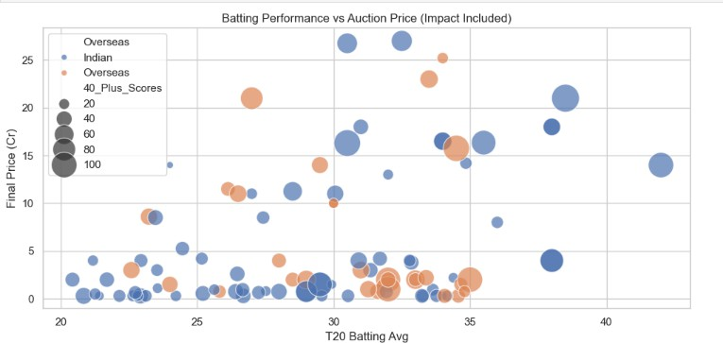
“Players with higher T20 batting averages and more 40+ scores tend to command higher auction prices, with overseas players showing a stronger price premium.”

Slide 15
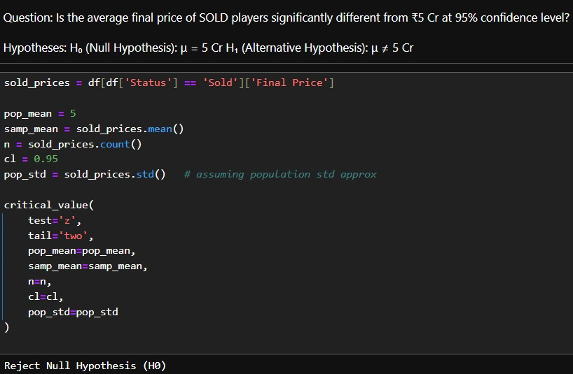
Hypothesis Testing
one-sample, two-tailed Z-test was conducted on the final prices of sold players at a 95% confidence level.
The null hypothesis assumed the average final price is ₹5 Cr.
The test statistic did not fall in the rejection region.
Hence, we failed to reject the null hypothesis (H₀).
This indicates the average sold price is not significantly different from ₹5 Cr.

Slide 16
Key Insights & Recommendations :
Key Insights:
The sold ratio of Indian players declined from 2025 to 2026, showing tougher competition and more selective buying by teams.
New players should focus on multi-skill ability and consistency to improve their chances of
getting sold in IPL auctions.
All-rounders and wicket-keepers attract higher average prices than specialists
Team spending patterns vary significantly across seasons (2025 vs 2026)
Several players are sold close to their base price, indicating limited bidding competition
Recommendations:
Teams should invest more in high-impact Indian players to ensure squad stability
Allocate higher budgets for multi-skill players (all-rounders, WK-batsmen)
Use data-driven budget allocation to avoid overpaying in competitive auctions
Monitor year-wise trends to adjust team strategies dynamically
Teams should focus on targeted Indian player selection and improve domestic talent scouting to sustain squad strength.

Slide 17
Conclusion
The IPL Auction 2025-2026 shows that auctions are performance-driven and budget-sensitive. Franchises focused more on foreign players, especially Australians, while purchases of Indian talent decreased, highlighting the need to encourage domestic players. Multi-talented
players remain
highly valued, and performance metrics like averages, 40+ scores, and 3-wicket hauls strongly
batting/bowling
influence selection and final price. Retention of experienced players is higher than unsold or newly sold ones, reflecting a preference for proven performers. These insights can guide franchises in decision-making and help players improve their auction value.
‹#›

Slide 18


‹#›

